Slide 1




Java Bootcamp 2018
Class 7:

Slide 2



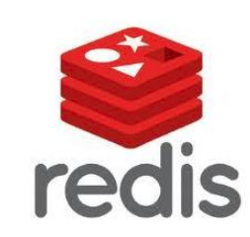

Java Bootcamp 2018 - Class 7: RDBS & Hibernate
What DBs have you worked with?

Slide 3
Java Bootcamp 2018 - Class 7: RDBS & Hibernate
Relational database
Data relationships in form of tables
Columns and Rows
Records and attributes
Unique key identifying each row
Standard API is SQL language
Data integrity
Achieved through constraints
PK, FK, NOT NULL, etc

Slide 4
Java Bootcamp 2018 - Class 7: RDBS & Hibernate
Relational database - Transactions
Transactions
One or more SQL statements as a single logical unit of work
All or nothing
Commit/Rollback

Slide 5
Java Bootcamp 2018 - Class 7: RDBS & Hibernate
Relational database - ACID
Atomicity
Transaction as a whole; if not, invalidate
Consistency
Data adheres to defined rules and restrictions
Isolation
Each transaction is independent
Durability
Changes are permanent

Slide 6
Java Bootcamp 2018 - Class 7: RDBS & Hibernate
Non-Relational database
Flexible schemas
Ease of development
Performance at scale
Large data volumes (Low latency, Flexible data models)

Slide 7
Java Bootcamp 2018 - Class 7: RDBS & Hibernate
Non-Relational database types
Document oriented
Key-value
Graph
Columnar
etc

Slide 8
Java Bootcamp 2018 - Class 7: RDBS & Hibernate
Relational vs Non-relational
 | Relational | Non-relational
Data model | Rows and columns | Graph, key-value, in memory, etc.
ACID properties | ACID compliance | Tradeoffs for a more flexible data model
Terminology | Table, row, column, PK | Collection, document, ObjectId
Examples | MySQL, PostgreSQL, OracleDB | MongoDB, ElasticSearch, Cassandra

Slide 9
Java Bootcamp 2018 - Class 7: RDBS & Hibernate
ORM
Object Relational Mapping
Programming technique for converting data between relational dbs and object oriented programming languages (Java, C#, etc)
Advantages over plain JDBC
Business code access objects rather than DB tables
Hide details of SQL queries from OO logic
No need to deal with DB implementation
Entities based on business concepts rather than db structure
Transaction management
Fast development of application

Slide 10
Java Bootcamp 2018 - Class 7: RDBS & Hibernate
JPA
Specification for the management of persistence and object/relational mapping with Java
Object/relational facility for Java devs using a Java domain model and a relational db
Map Java POJOs to relational dbs
Hibernate is a full JPA implementation with additional native features
Annotations
@Entity
@Id
@Transient

Slide 11
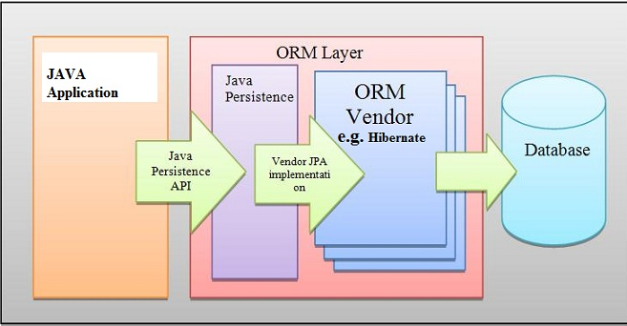
Java Bootcamp 2018 - Class 7: RDBS & Hibernate
ORM

Slide 12
Java Bootcamp 2018 - Class 7: RDBS & Hibernate
Hibernate
High performance ORM
Data query and retrieval facilities
Persistence Framework
Open source
Provides simple API for storing and retrieving Java objects directly from DB

Slide 13
Java Bootcamp 2018 - Class 7: RDBS & Hibernate
Hibernate - Persistent Entities
POJOs
Typically represent a table in a relational DB
Each instance corresponds to one row in that table
Have a persistent identity
May have both persistent and transient (non-persistent) state
transient identifier or @Transient annotation

Slide 14
Java Bootcamp 2018 - Class 7: RDBS & Hibernate
Hibernate - Persistence Concepts
Persistence Unit (PU)
Set of entity classes managed by the EM in an app. Mapping to rdb
Persistence Context (PC)
Set of managed instances that exist in a particular data store. Runtime context
EntityManager (EM)
API for interaction with PC
Manipulates and controls PC lifecycle
Creates and removes persistent entity instances
Finds entities by PK
Runs queries on entities

Slide 15

Java Bootcamp 2018 - Class 7: RDBS & Hibernate
Hibernate - Entity Manager
Persistence Unit
Configuration in persistence.xml
EntityManager persist() remove() refresh() merge() find() contains() flush() createQuery()
createNamedQuery()
Managed Entity
Managed Entity
Play application
Persistence Context

Slide 16

Java Bootcamp 2018 - Class 7: RDBS & Hibernate
Hibernate - Entity Lifecycle
No longer associated with persistence context
PC ends
updates
new()
Detached Entity
New Entity
Persistence Context
merge()
persist()
Managed Entity
Managed Entity
Managed Entity
Transaction commit
Guaranteed scope of object identity
remove()
Only one managed entity in PC represents a row
Removed Entity

Slide 17
Java Bootcamp 2018 - Class 7: RDBS & Hibernate
Hibernate - persistence.xml
conf/META-INF/persistence.xml
<persistence xmlns="http://java.sun.com/xml/ns/persistence" xmlns:xsi="http://www.w3.org/2001/XMLSchema-instance" xsi:schemaLocation="http://java.sun.com/xml/ns/persistence http://
java.sun.com/xml/ns/persistence/persistence_2_0.xsd" version="2.0">
<persistence-unit name="defaultPersistenceUnit" transaction-type="RESOURCE_LOCAL">
<provider>org.hibernate.ejb.HibernatePersistence</provider>
<non-jta-data-source>DefaultDS</non-jta-data-source>
<properties> <property name="javax.persistence.jdbc.driver" value="org.hsqldb.jdbcDriver"/> <property name="javax.persistence.jdbc.user" value="sa"/> <property name="javax.persistence.jdbc.password" value=""/> <property name="javax.persistence.jdbc.url" value="jdbc:hsqldb:."/> <property name="hibernate.dialect" value="org.hibernate.dialect.HSQLDialect"/ <property name="hibernate.max_fetch_depth" value="3"/>
</properties>

Slide 18
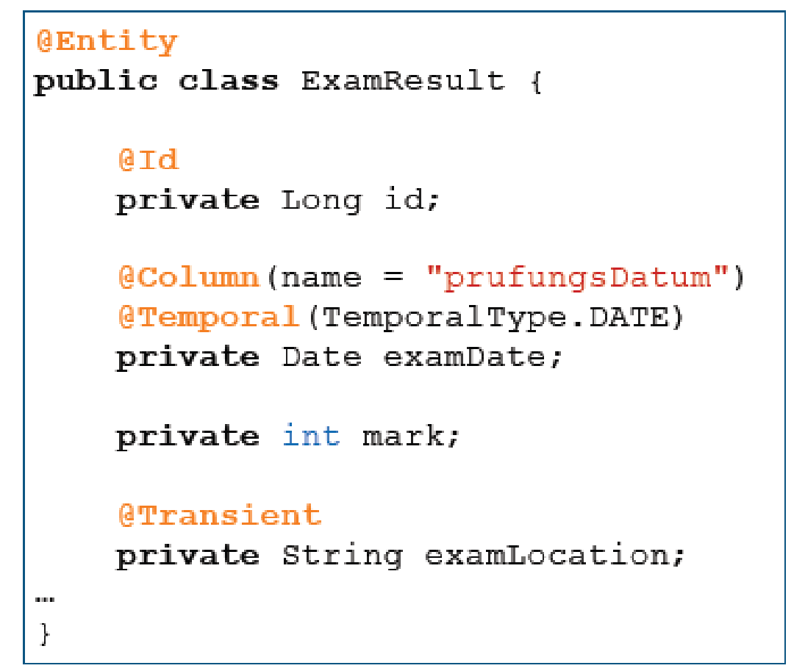
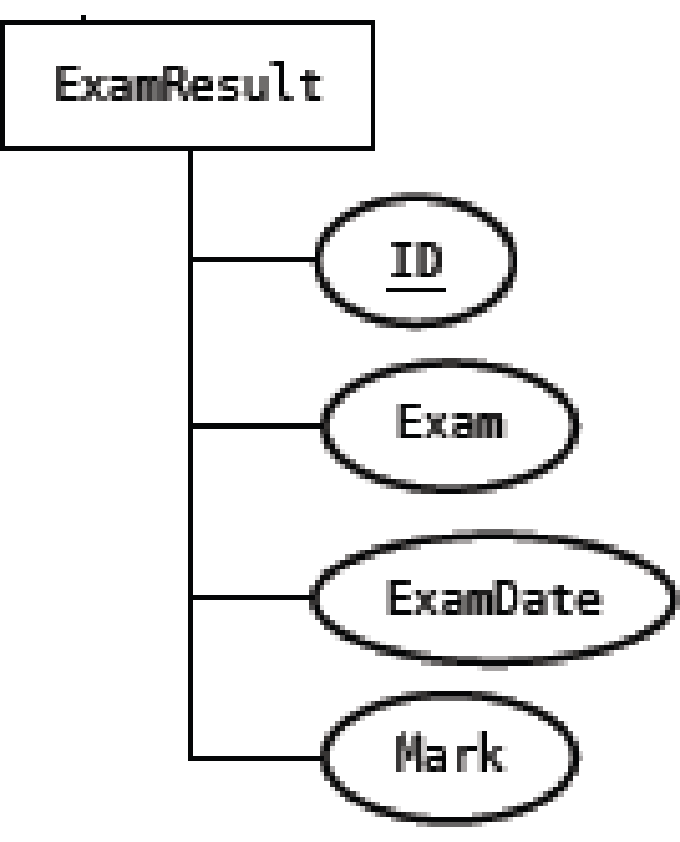

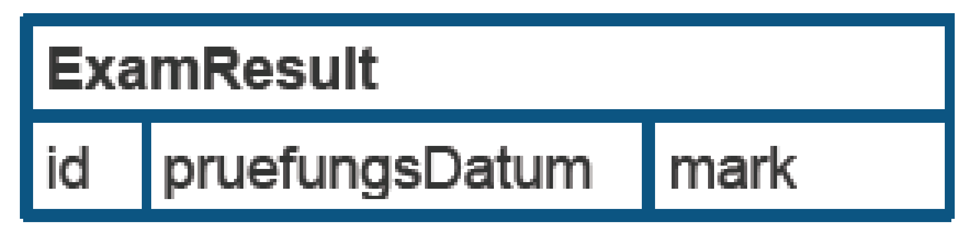
Java Bootcamp 2018 - Class 7: RDBS & Hibernate
Examples - Simple Mapping

Slide 19
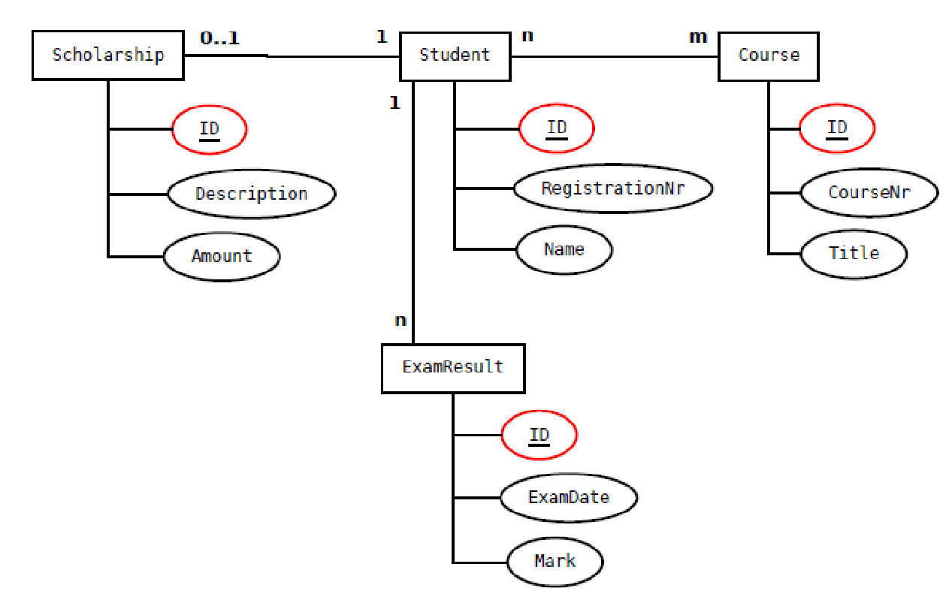
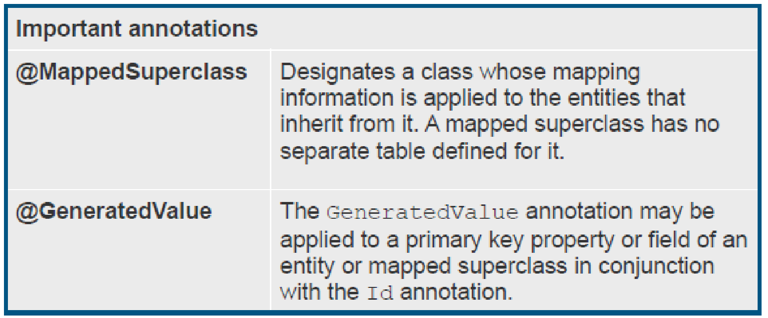
Java Bootcamp 2018 - Class 7: RDBS & Hibernate
Examples - Inheritance

Slide 20
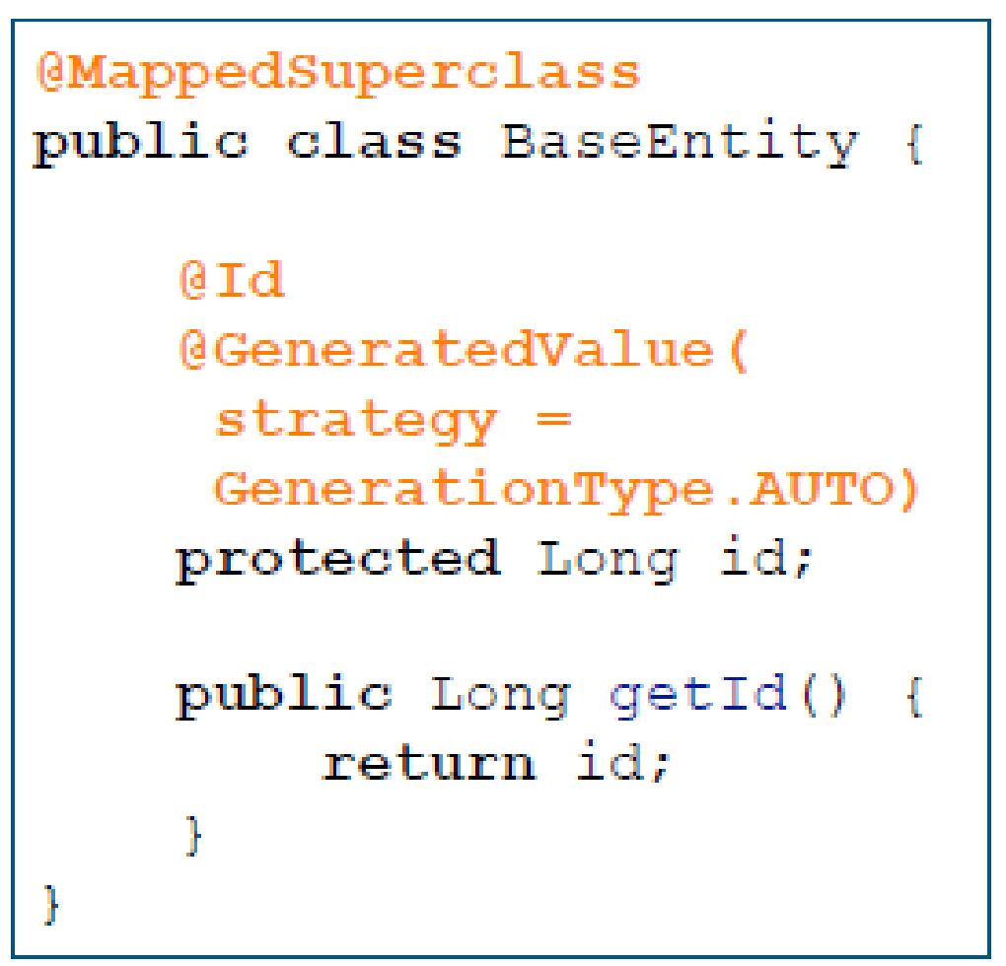
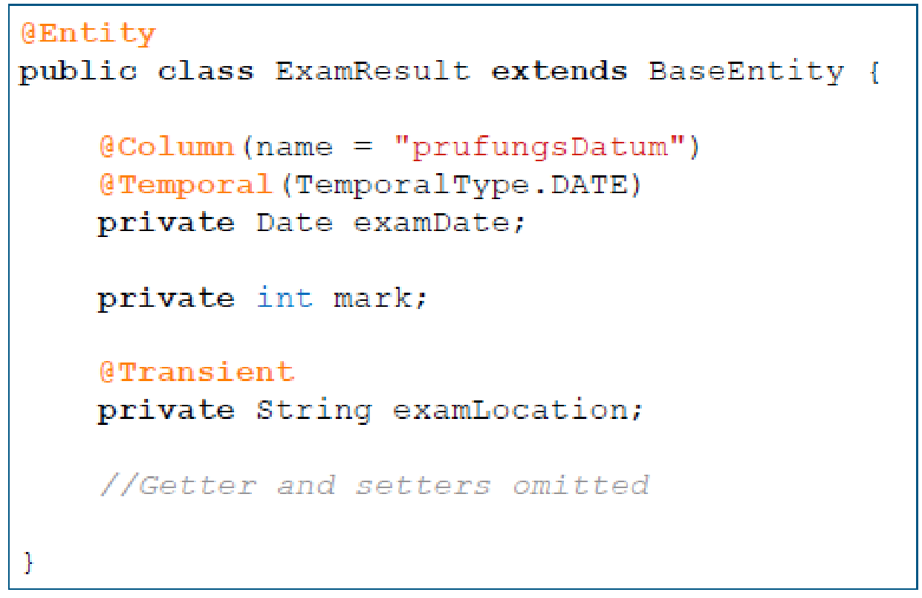
Java Bootcamp 2018 - Class 7: RDBS & Hibernate
Examples - Inheritance

Slide 21
Java Bootcamp 2018 - Class 7: RDBS & Hibernate
Entities relationships
Unidirectional
One-to-one
One-to-many
Bidirectional
Many-to-one
Many-to-many
Need to specify the owning side in relationships
One-to-one: side where the FK is specified
One-to-Many, Many-to-one: the many side

Slide 22
Java Bootcamp 2018 - Class 7: RDBS & Hibernate
Entities relationships - @FetchType
Lazy
Do not load referenced entity until it is accessed for the first time
Careful with LazyInitializationException
Eager
Load referenced entity immediately

Slide 23
Java Bootcamp 2018 - Class 7: RDBS & Hibernate
Entities relationships - @CascadeType
Defines the set of cascadable ops that are propagated to associated entity
PERSIST
MERGE
REMOVE
REFRESH
DETACH
ALL (includes all the previous ones)
Default: NONE
OrphanRemoval: for @OneToOne and @OneToMany. Default: false

Slide 24
Java Bootcamp 2018 - Class 7: RDBS & Hibernate
Entity Manager Samples
public void persist(BaseEntity entity){ em().persist(entity);
}
Make an entity instance managed and persistent. Throws EntityExistsException, if the entity instance already exists.
public <T extends BaseEntity> T merge(T entity) {
return em().merge(entity);
}
Make an entity instance managed and persistent. If it does not exist yet, persist it. If it already exists, the entity instance is updated.
public <T extends BaseEntity> T findEntity(Long id, Class<T> entityClazz) {
return em().find(entityClazz, id);
}
Find the entity instance using the primary key.
public void remove(BaseEntity entity){ em().remove(entity);
}
Remove the instance.

Slide 25
Java Bootcamp 2018 - Class 7: RDBS & Hibernate
Spring Data
JPA with Spring: https://spring.io/guides/gs/accessing-data-jpa/
Provides a Spring based programming model for data access
Data access technologies with relational and non-relational databases
Repository and custom object-mapping abstractions
Several modules
JPA
JDBC
KeyValue
LDAP
MongoDB
Redis
Long etc

Slide 26
Java Bootcamp 2018 - Class 7: RDBS & Hibernate
Spring Data
public interface CustomerRepository extends CrudRepository<Customer, Long> { List<Customer> findByLastName(String lastName);
Iterable<T> findAll();
Long count();
Void delete(T entity); }

Slide 27
Java Bootcamp 2018 - Class 7: RDBS & Hibernate
Any questions?

